Slide 1


A Final Presentation on
Neurology Diagnosis System
Under supervision of
Prof. Dr. Shashidhar Ram Joshi
(Mentor: Bikram Lal Shrestha)
Presented by:
Badri Adhikari
Md. Hasan Ansari
Priti Shrestha
Susma Pant
Notes:
Good afternoon everyone and thank you for inviting D2Hawkeye to your meeting today. Pete Bauch and I are pleased to be with you and welcome the opportunity to discuss the power of data mining and predictive modeling.

Slide 2
Objectives
Following were the main objectives of the project.
1. To develop a web based hybrid expert system to help the neurology diagnosis process.
2. To review Artificial Intelligence literature in Expert Systems and estimate the Expert System model that fits in field of neurology.

Slide 3
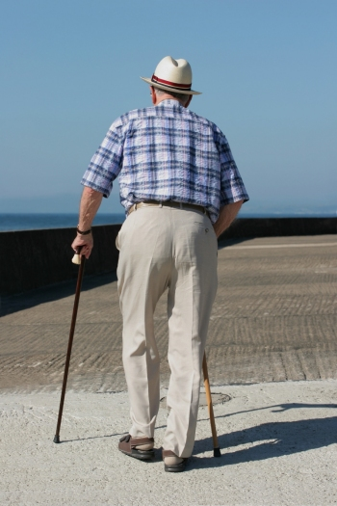
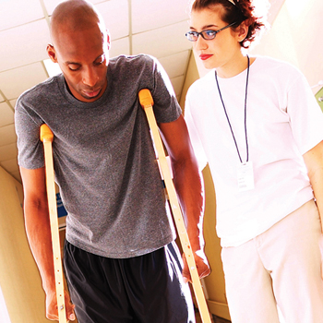
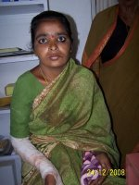
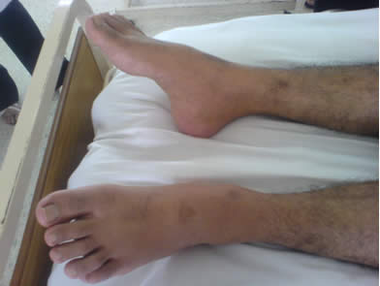
Neurologic Disorders
There are 180 million neurologic patients only in America.

Slide 4
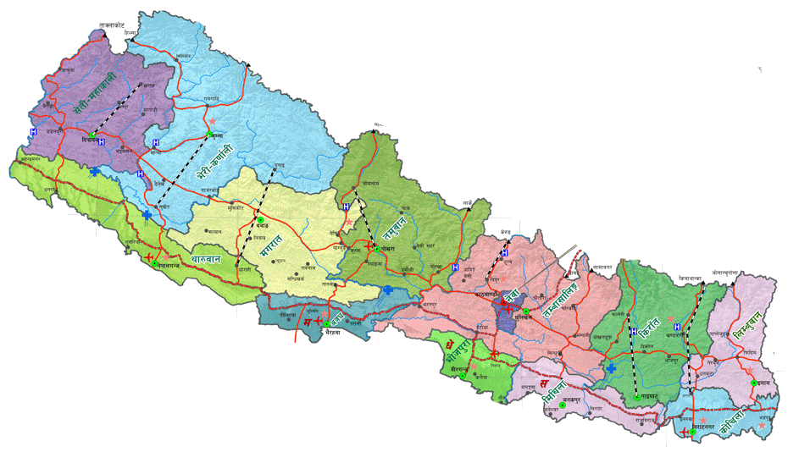
Implementation and Scope
Total Population: 25 million
Rural Population: 20 million
Urban Population: 5 million
Most of the Neurology experts serve at Urban areas.
How to provide experts’ medical care facilities to these 20 million rural people?
- Expert Systems come to rescue.

Slide 5
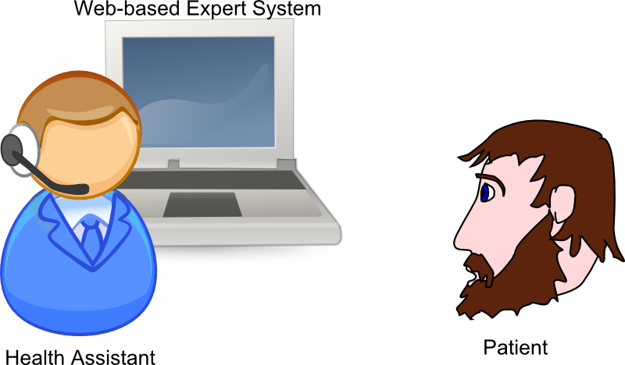
System in-action
Option 1
Option 2
Option 3
Option 4
Step 1: Train health assistants to use the expert system.
Step 2: Establish Internet facilities at remote places.
Step 3: Use the system to diagnose patients.

Slide 6
Why Neurology?
Complex domain
Non-risky domain
1. Why complex domain?
To see whether artificial reasoning
actually works.
2. Why consider risk?
Because patients may be ……
due to wrong diagnosis.
Began with: Neurosurgery
Neurosurgery
Concluded: Neurology

Slide 7
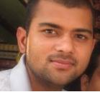
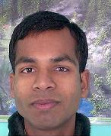
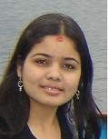
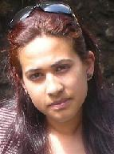
Where are we?
Project Overview
Methodology
Testing and Results
Discussion and Conclusion

Slide 8
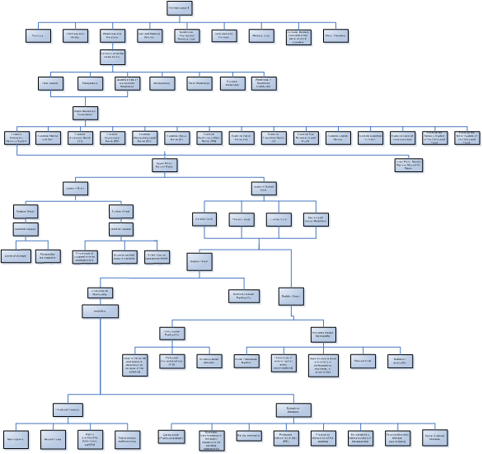
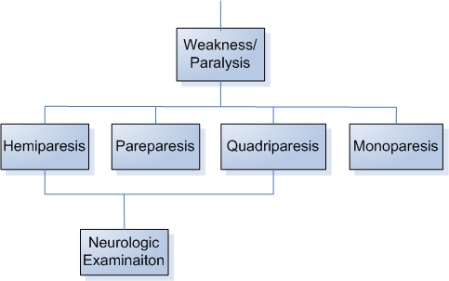
Decision Tree

Slide 9
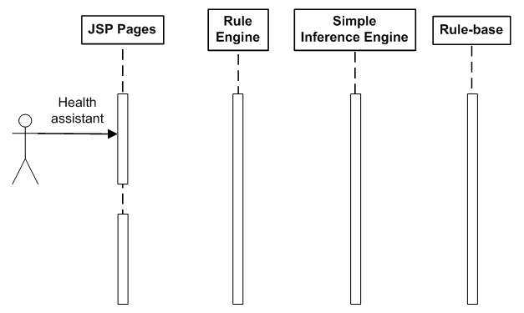
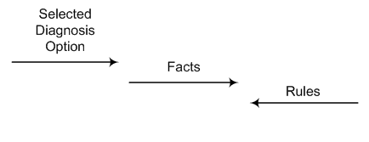
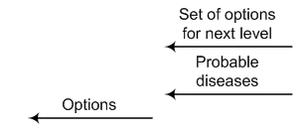
Sequence Diagram

Slide 10
Case-base
Template for cases.
Representative cases of patients are stored in the case-base.
These cases are retrieved as similar cases.
Case base
New
case
Similar
cases

Slide 11
Where are we?
Project Overview
Methodology
Testing and Results
Discussion and Conclusion

Slide 12
Testing of Rule-based Reasoning
Rule-based component of the system was tested at Neurology O.P.D. of T.U. Teaching Hospital.
We tested 13 neurologic patients whose status was input into the system.

Slide 13
Testing of NN Algorithm
Technology Used | Input | Output
WEKA
Neurology Diagnosis System
A set of 50 different cases with unique ids ranging from 1 to 50.
A new case with id 51.
A set of 50 different cases with unique ids ranging from 1 to 50.
A new case with id 51.
One of the cluster of 3 cases had ids 12 and 13, and 51.
Two cases with ids 12 and 13.(same)
In WEKA, Simple K-Means algorithm was applied with K as 17 .
The similar cases displayed by the system, were found to be exactly same as those shown by WEKA .

Slide 14
Feedbacks
“ The project can be integrated with existing PHR of D2. It has a lot of scope.”
  - Dr. Rajesh Pyakurel (D2Hawkeye Services)
“ Its useful. These kinds of system will be prevalent in near future. The concept can be used in other domains as well.”
  Dr. Umesh Khanal (D2Hawkeye Services)
“ Most patients have common and similar problems. It can be effectively used to solve common neurologic problems. Case-based part could be more useful.”
  - Dr. Chhabindra Nepal (T.U.T.H.)

Slide 15
Where are we?
Project Overview
Methodology
Testing and Results
Discussion and Conclusion

Slide 16

Results of Rule-based Diagnosis
Which option to select?
During the diagnosis, problems were faced.
Not enough evidences to precisely select the options provided by the system.

Slide 17
Results of Case-based Reasoning
It was observed that case-based reasoning could effectively find relevant cases if common cases were inserted into the case-base.
The case-base required cases to be in a particular format.
This format could not be changed after development.
This created a restriction that cases be represented in pre-specified format.

Slide 18
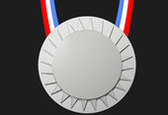

RBR versus CBR Results
Rule-based reasoning provided no opportunity to handle exceptions and unusual cases.
Case-based reasoning provided the mechanism to handle exceptions by providing the feature to add cases in any combination.
RBR
CBR

Slide 19
Comparison with Other Medical Systems
Author / System | Representative Cases | Hybridity | Everyday use | Reliability
Schmidt/TeCoMED | 3000 | CBR most imp. | Largely | Large
Nilsson/Stress diagnosis | 20 | CBR most imp. | No | No
Montani/Hemodialysis | 1000 | Pure CBR | No | No
Montani/Diabetes (MMR) | 150 | Hybrid | Some extent | No
Costello/Gene finding | w948 | Pure CBR | No | No
Evans-Romaine/WHAT | 25 | CBR most imp. | No | Some extent
Marling/Auguste | 28 | Hybrid | No | No
Perner/Fungi identification | 100 | Pure CBR | Some extent | No
Perner/Image segm | 1000 | RBR | Planned | No
El Balaa/FM-Ultranet | 130 | Pure CBR | No | Some extent
NDS Team/Neurology Diagnosis System | ? | Hybrid | No | Some extent

Slide 20
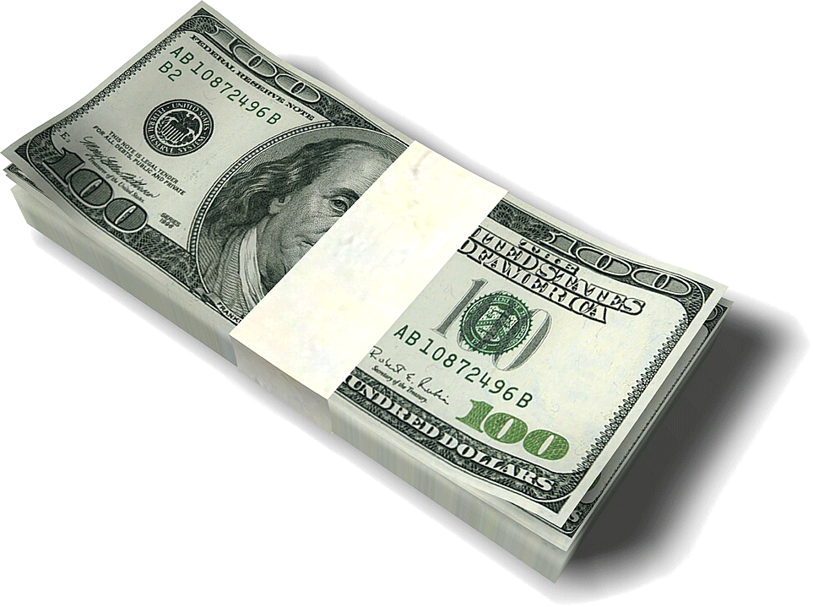
Enhancements
1. Involving Group of Neurologists for Knowledge Engineering
    Improve the quality and quantity on knowledge by cooperative participation of multiple neurologists.
2. Inserting Representative Cases
    By collecting real cases form neurology hospitals and feeding the system with that knowledge will make the system an experienced neurology expert.
3. Paid Maintenance Team of Neurologists
    Keep the knowledge of the system up-to-date.
4. Adding Common Sense
    Any existing database of common sense may be integrated with the system to make it a competitive AI application.

Slide 21
References
Advancements and Trends in Medical Case-Based Reasoning; Markus Nilsson, Mikael Sollenborn; Malardalen University.
Population census 2005, Nepal.
Harrison's Principles of Internal Medicine, 2008.

Slide 22
Thank You
for
Your Time
QUERIES??

